Slide 1


SIMATS ENGINEERING
SAVEETHA INSTITUTE OF MEDICAL AND TECHNICAL SCIENCES
Segmenting Building Rooftops from an Aerial Orthophoto
DSA0205- Computer Vision with Open CV
Abdul Razak Shaik (192524358)

Slide 2
ABSTRACT
Building rooftop extraction from aerial orthophotos is an important task in urban mapping, planning, GIS analysis, and 3D city modelling. Manual identification of rooftops is time-consuming and difficult for large areas. This project proposes an automated semantic segmentation approach to identify building rooftops from high-resolution aerial orthophotos. A U-Net-based deep learning model is used to classify each pixel as either building or background. The predicted segmentation mask is then refined using post-processing techniques and converted into rooftop polygons. The proposed workflow can provide accurate and scalable building-footprint extraction for applications such as urban planning, disaster management, and geospatial analysis.

Slide 3
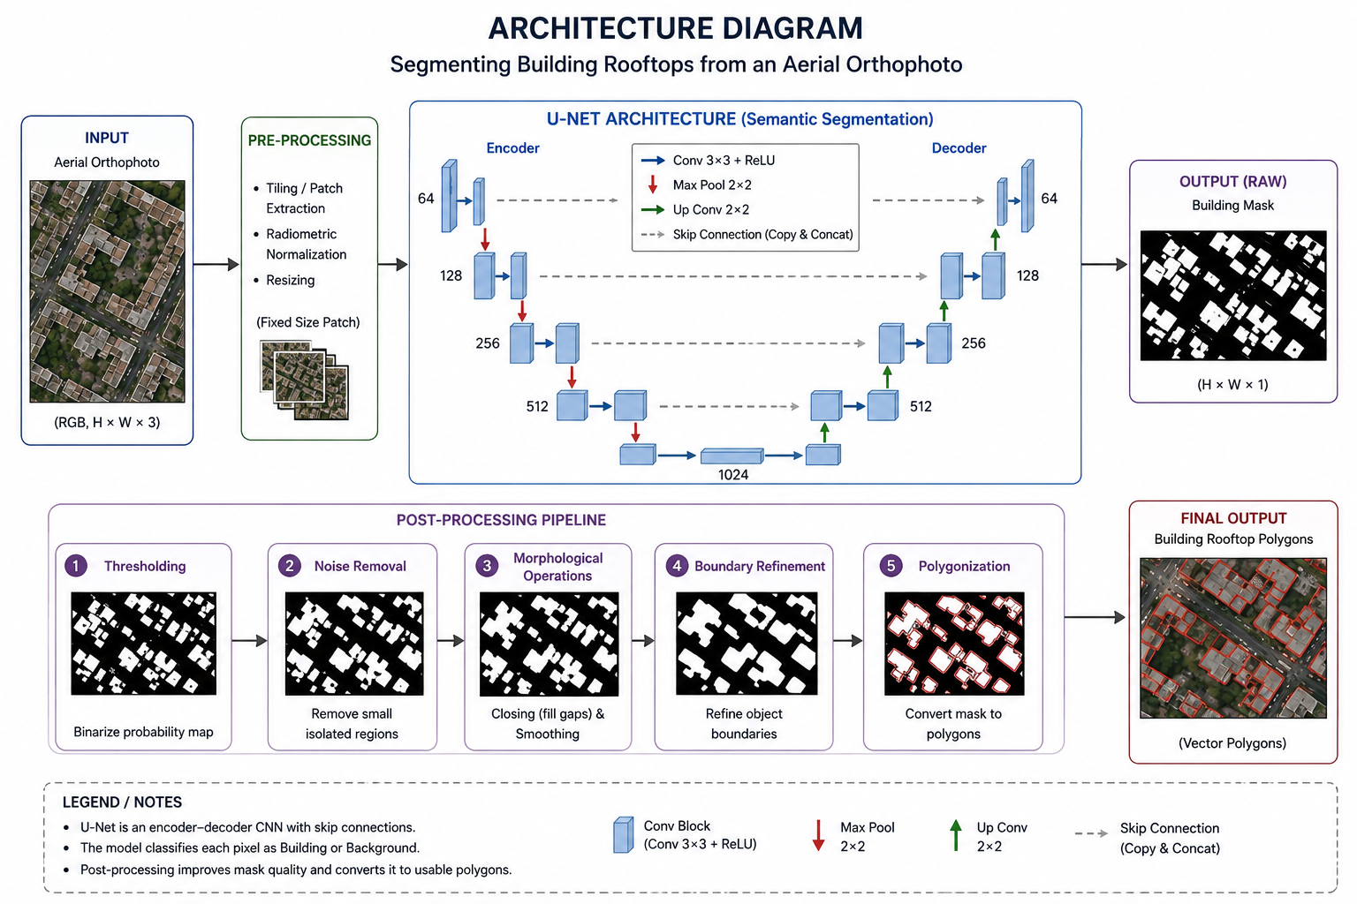

Slide 4
Methodology
1. Data Preparation
Collect aerial orthophotos
Create/obtain building labels
Resize and normalize images
2. Model Training
Train a U-Net semantic segmentation model
Input: orthophoto
Output: building/non-building mask
3. Prediction
Apply the trained model to unseen aerial images
Generate building probability/segmentation masks
4. Post-processing
Remove small noisy regions
Fill gaps
Refine building boundaries
5. Polygon Extraction
Convert the final mask into rooftop polygons
Export for GIS or 3D modelling

Slide 5
Conclusion
Automates rooftop extraction from aerial imagery.
Reduces manual digitization effort.
U-Net can effectively learn building/non-building patterns.
Polygon outputs can support GIS and urban-planning applications.
Future work: improve performance on complex roofs, shadows, dense urban areas, and multi-level buildings.

Slide 6
THANK YOU

